Slide 1
PayGaze Gaze the Pay, Lead the Way
CAPSTONE PROJECT
Presented By:
Name: Kolla Venkata Pradeep
Collage Name: PDPM IIITDM Jabalpur
Branch: BTech-CSE
AICTE Internship Student Registration ID : STU682c65f11a0921747740145

Slide 2
OUTLINE
Problem Statement
System Development Approach
Algorithm & Deployment
Result
Conclusion
Future Scope
References

Slide 3

Problem Statement
Imagine two employees working in the same company — one gets paid well, while the other feels underpaid despite doing similar work. This is a common issue in many places, where salaries don’t always match a person’s experience, education, or job role. Often, companies struggle to decide fair salaries because there are too many factors to consider. At the same time, job seekers are unsure if the offers they get match industry standards. This gap between skills and salary expectations creates confusion, dissatisfaction, and even employee turnover.

Slide 4

System Approach
System requirements:
Processor: Intel i3 or above
RAM: Minimum 4 GB
Operating System: Windows, macOS, or Linux
Software: Jupyter Notebook / VS Code, Streamlit
Python Version: 3.7 or above
Library required to build the model:
pandas – for data handling and preprocessing
numpy – for numerical operations
scikit-learn – for model building (Linear Regression, Random Forest, etc.)
xgboost – for XGBoost regression model
joblib – to save and load the trained model
streamlit – to create a user-friendly web interface
matplotlib / seaborn (optional) – for visualizations during EDA

Slide 5
Algorithm & Deployment
Step-by-Step Procedure
Collected the Dataset Downloaded a dataset from Kaggle containing employee details like gender, age, education level, salary etc.
Explored and Cleaned the Data Removed duplicates, handled missing values, and dropped unnecessary columns. Outliers in age were also addressed to improve accuracy.
Preprocessed the Data Converted categorical columns like gender, education, and job title using OneHotEncoding to make them readable for the model and scaled the numerical values using MinMaxScalar.
Split the Dataset Divided the data into training and testing sets to train the model on one part and test its performance on unseen data.
Trained Multiple Models Built and trained three different models — Linear Regression, Random Forest, and XGBoost — to compare their performance.
Evaluated the Models Used metrics like R² Score, MAE, and RMSE to find the best model. XGBoost performed the best and was saved for predictions.
Created a Web App with Streamlit Built an interactive app using Streamlit where users can enter employee details or upload a CSV file to predict salaries in real time.
Tested the App Ran the app locally to test both individual and batch prediction functionalities. Adjusted UI for better user experience.

Slide 6
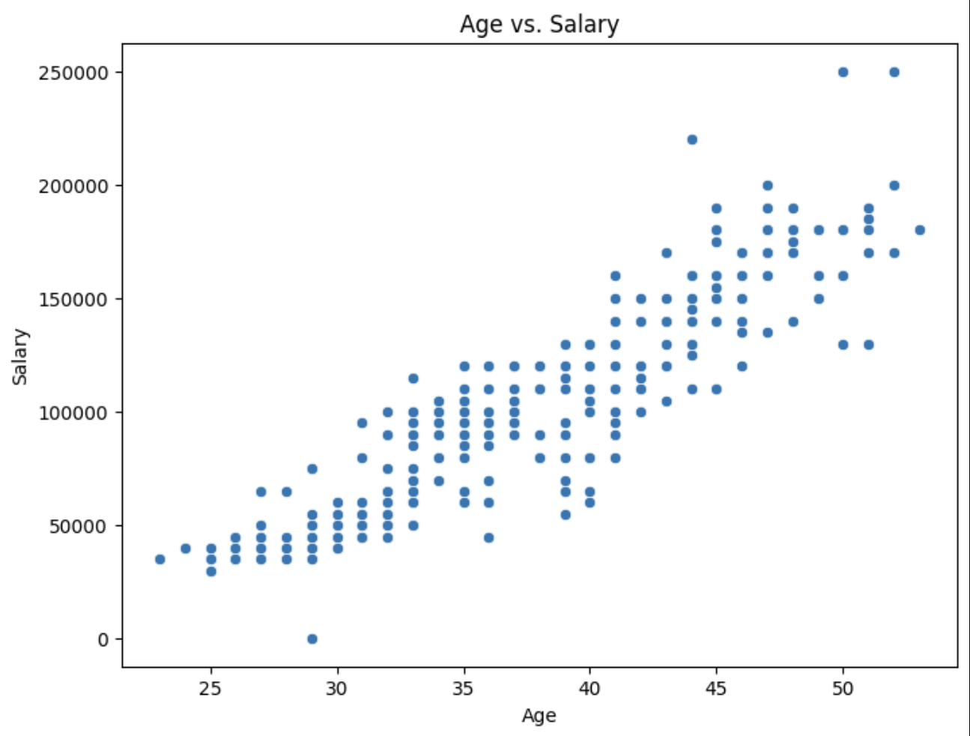
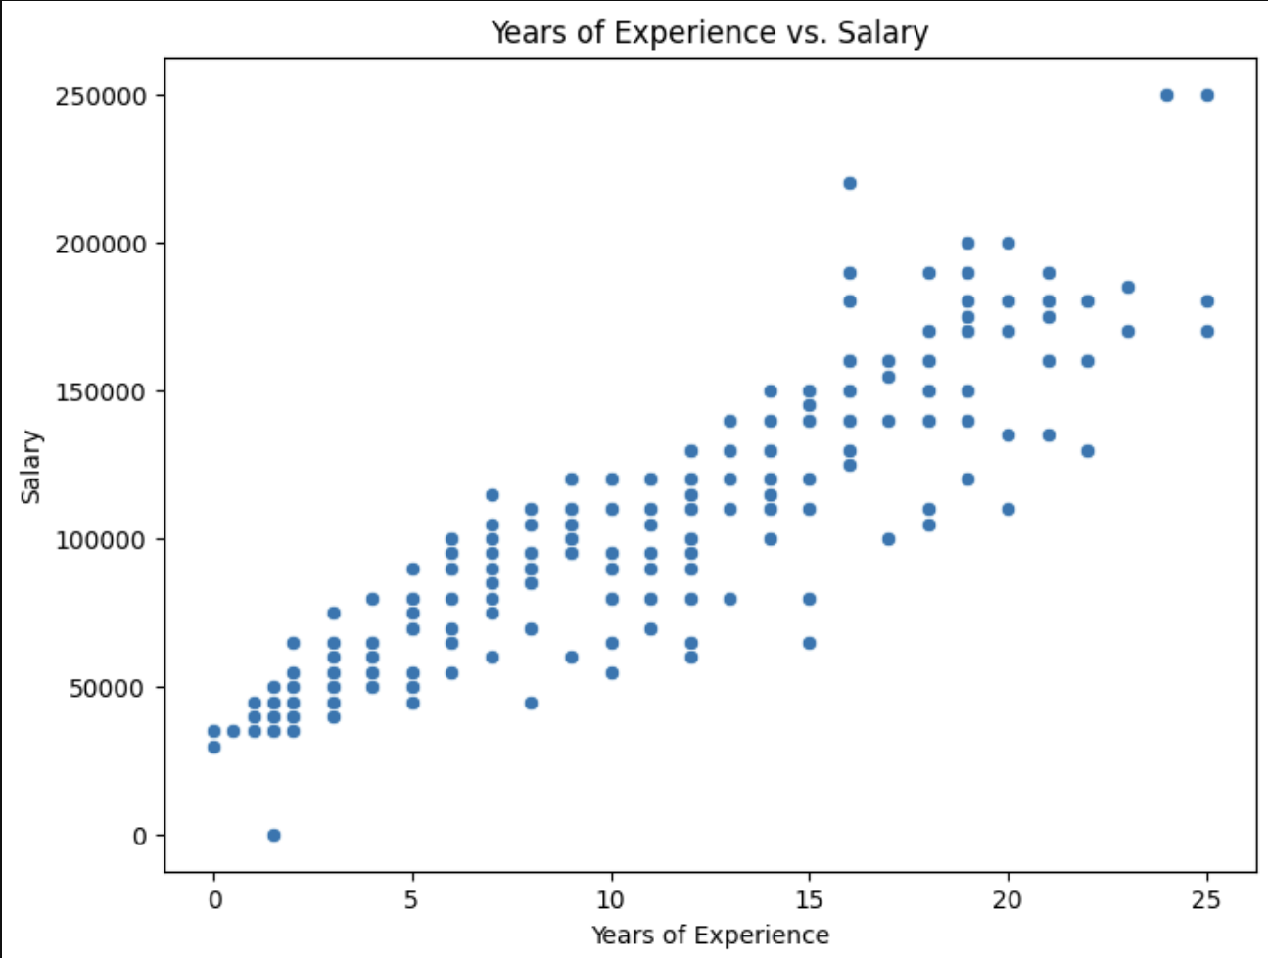
Results
Jupyter notebook results

Slide 7
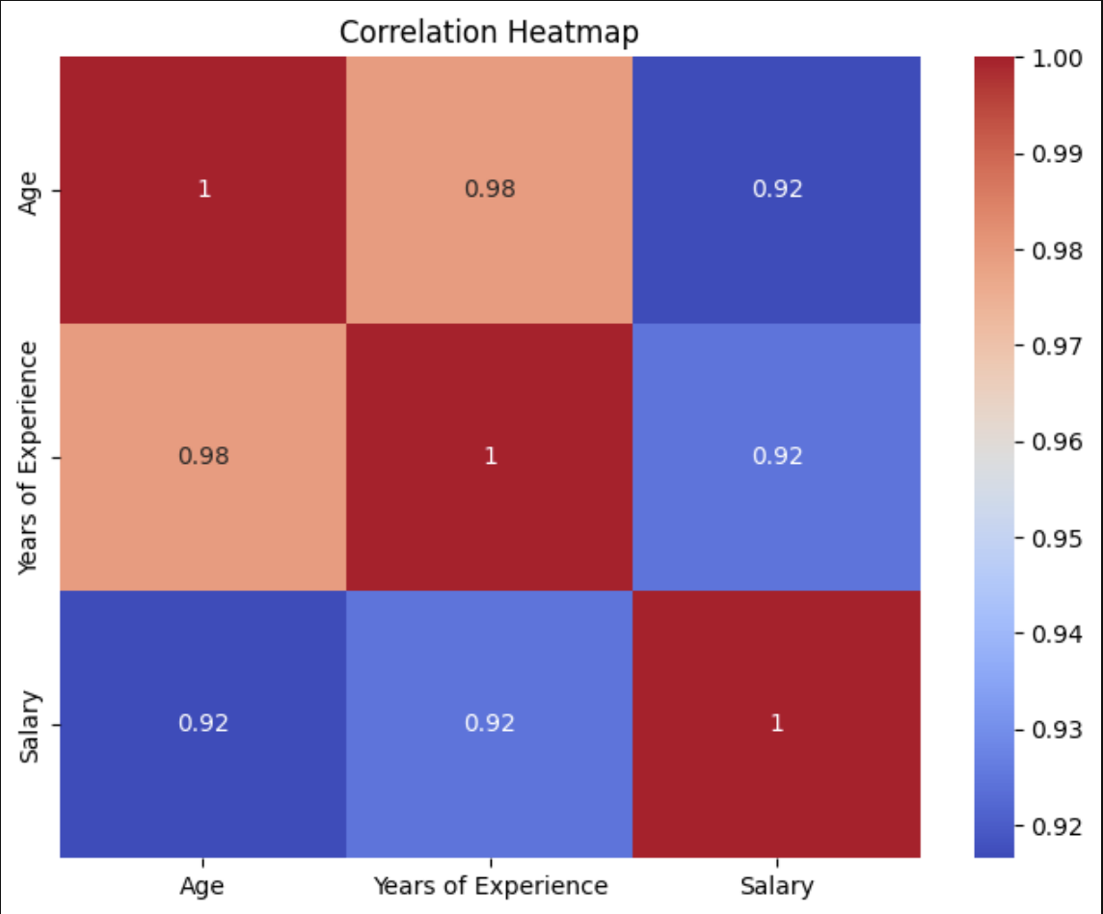
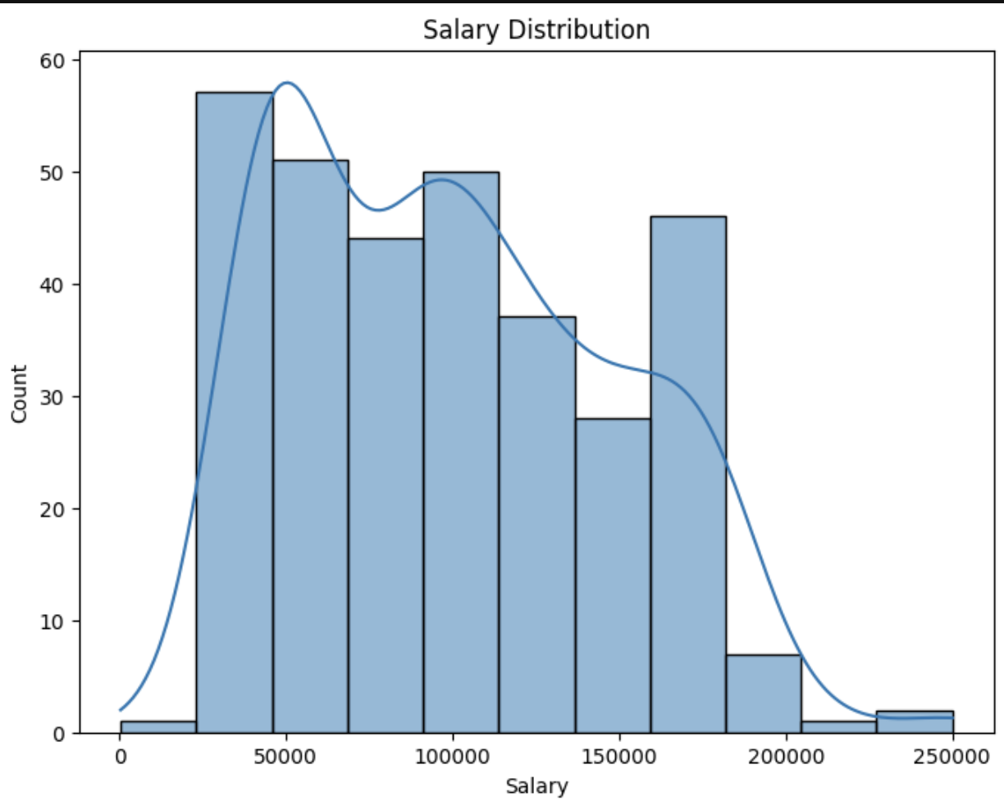
Results

Slide 8
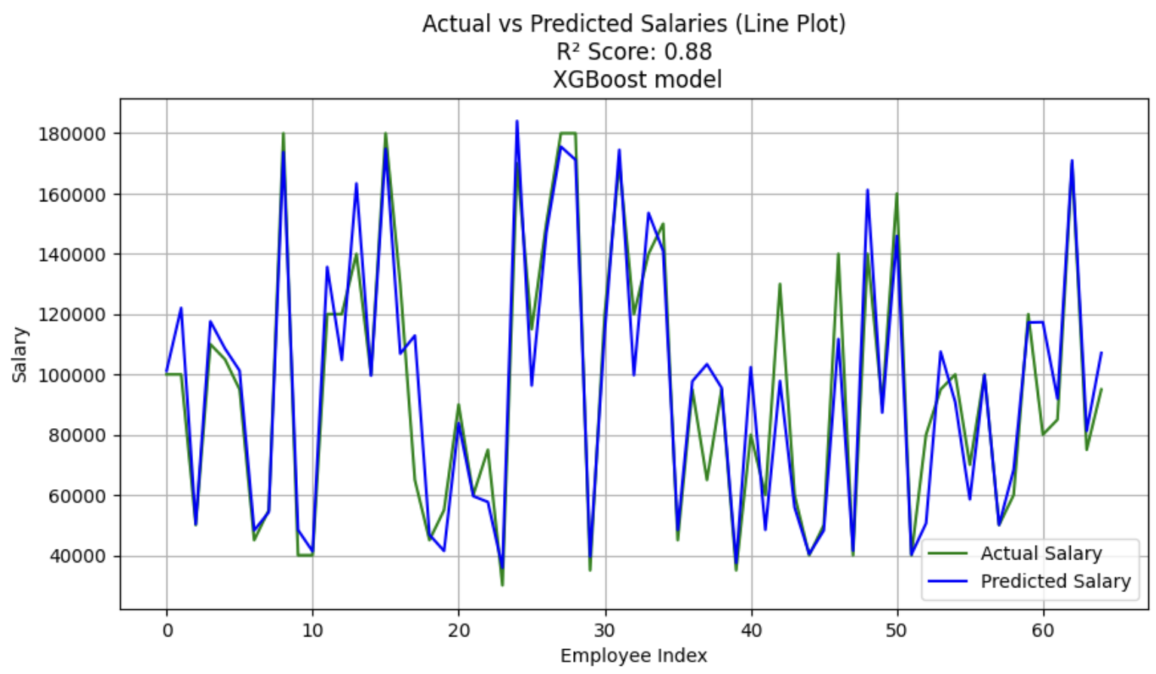
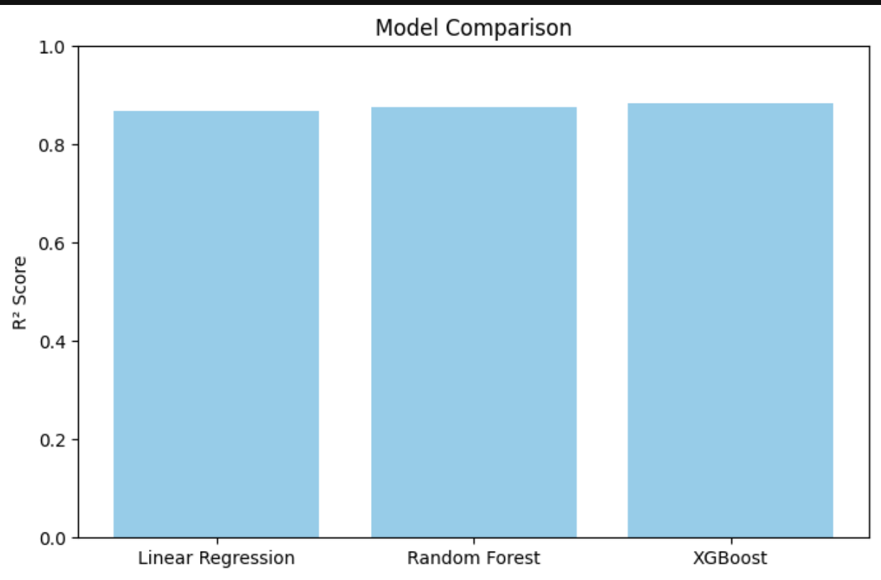
Results
Model Graphs

Slide 9
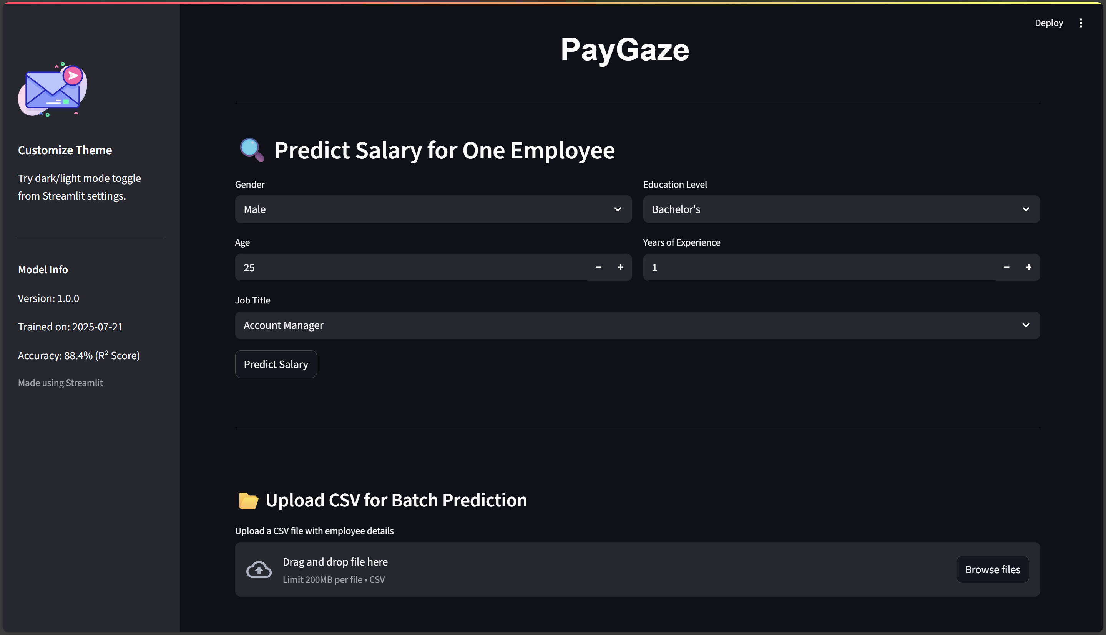
Results
Streamlit web application screenshots

Slide 10
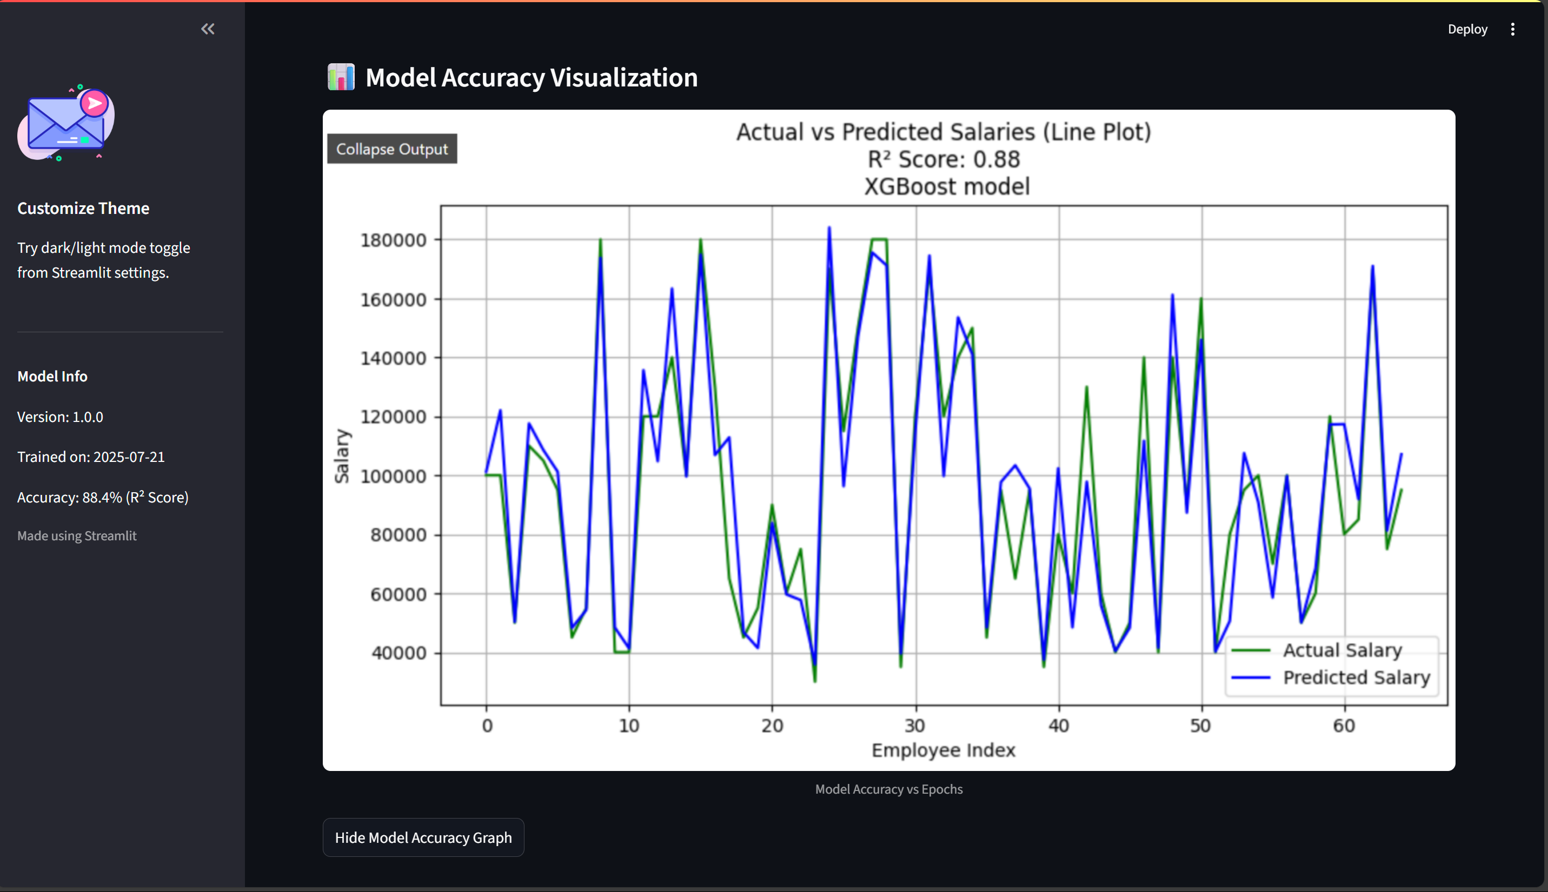
Results

Slide 11
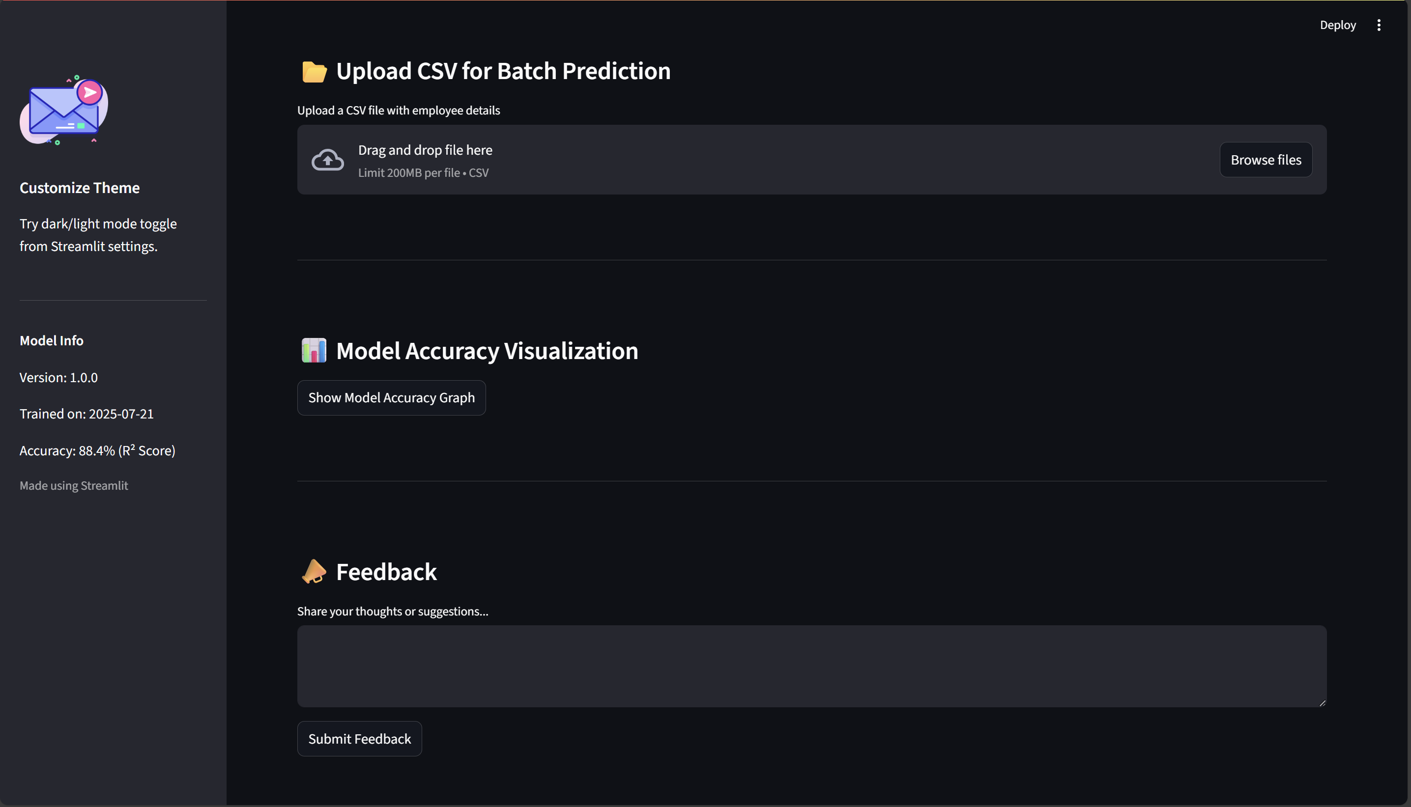
Results

Slide 12
GitHub
Link:
https://github.com/kvpradeep279/PayGaze-Salary-Prediction.git

Slide 13
Conclusion
Summary of Findings and Discussion
In this project, we aimed to build a system that can accurately predict employee salaries based on key details like gender, age, education level, job title, and experience. Using machine learning techniques, especially the XGBoost model, we achieved a good level of prediction accuracy. The model was trained on cleaned data and tested using unseen samples, where the predicted salaries closely matched the actual values, as shown in the "Actual vs Predicted" graph.
Effectiveness of the Solution
The model performed well on real-world-like data and gave predictions within a reasonable range.
The Streamlit-based web app provides a simple and interactive way for users to predict salaries, either for a single employee or in bulk using a CSV
The dropdowns, batch upload, and downloadable results make the system easy to use even for non-technical users.
Challenges Faced
The original dataset contained missing values, duplicate records, and some irrelevant columns, which had to be cleaned before training.
Handling categorical data like job titles and education levels required proper encoding to avoid bias in predictions.
Ensuring that the web app runs smoothly with both individual and batch predictions required testing and debugging.
Scope for Improvements
We can apply the deep neural network techniques, also fine-tuning hyperparameters could help in improving prediction results.
Currently, the model uses basic inputs like age, gender, education, job title, and experience. We can improve accuracy by adding more details such as location, company size, department, skill set, and industry type.

Slide 14
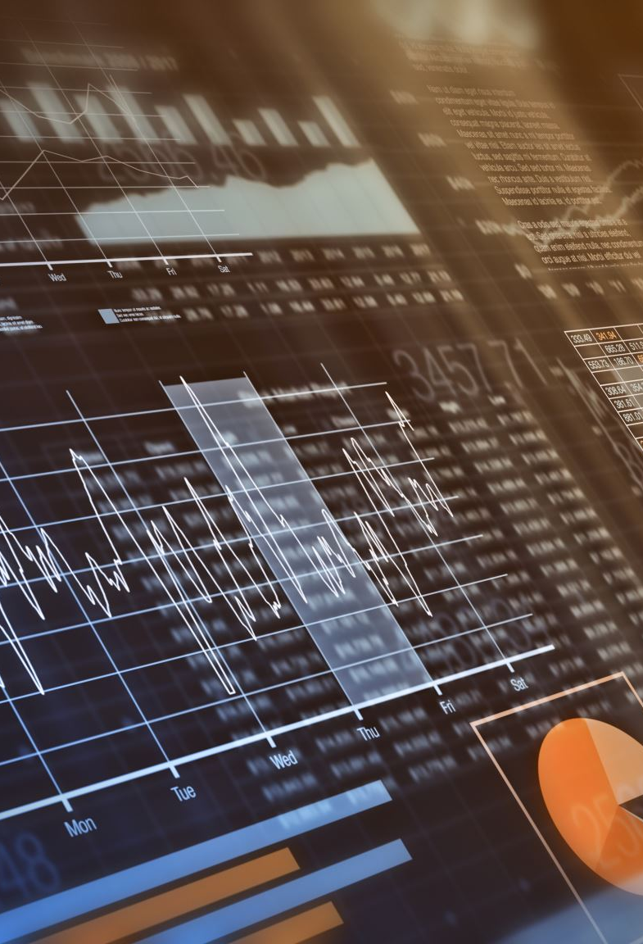
Dashboard & Insights Add a separate dashboard to visualize salary trends by job title, experience, or education. This would turn the app into not just a prediction tool, but also a data analysis platform.
Authentication and User Accounts Add login and signup features so that HRs or users can save their predictions, upload files privately, or revisit past results.
API Integration Convert the model into an API so it can be connected to HR portals, internal tools, or other applications for real-time use
Mobile-Friendly Interface Make the Streamlit UI more responsive or deploy it with a mobile-first design so users can use it easily from their phones or tablets.
Future scope

Slide 15
References
Kaggle Dataset
The employee salary dataset was sourced from Kaggle, a well-known platform for data science and machine learning datasets. Link: https://www.kaggle.com
Class Lectures and Teacher-Provided Resources
Concepts like data preprocessing, feature encoding, model selection, and evaluation techniques were learned through classroom sessions. Additionally, the .ipynb Jupyter notebook shared by the instructor was very helpful in understanding how to structure the project and implement it using concepts like pipelining and libraries such as pandas, sklearn, and joblib.
Streamlit Documentation
Used to understand how to create interactive UIs and deploy machine learning models for end users. Link: https://docs.streamlit.io

Slide 16
THANK YOU

